Slide 1
BOSS MOBILE PROJECT
2017144027 이승현
2018158015 박준희
2018158026 이정동

Slide 2
CONTENTS
01
02
03
INTODUCTION
SPRINT
FEATURE

Slide 3
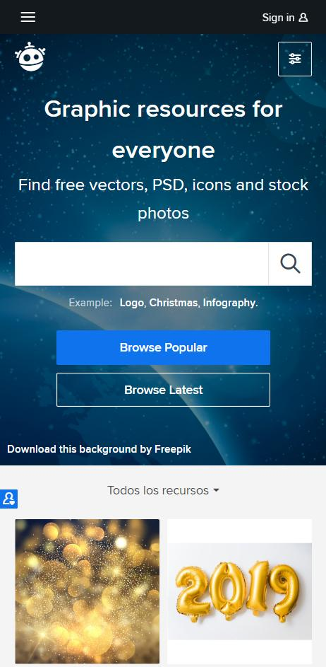


INTRODUCE
맛집 등록
음식점 표시
맛집 공유
NEPTUNE
Neptune is the eighth planet.
맛이어때
VER 1.0.0

Slide 4




Tools

Slide 5
Sprint
1
2
3
7.27~8.1
8.2~8.8
8.8~8.10

Slide 6
Sprint 1 7.27~8.01

Slide 7
Sprint 2 8.02~8.8

Slide 8
Sprint 3 8.08~8.10

Slide 9
APP FEATURE

Slide 10
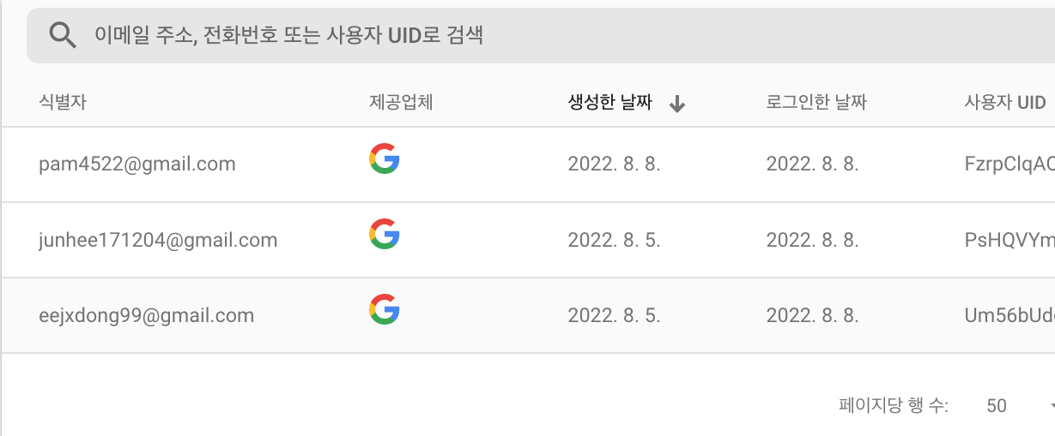
Sign In
NEPTUNE
Neptune is the eighth planet.

Slide 11
MAP
지역검색
지도 전환
내 위치 이동
NEPTUNE
NEPTUNE
Neptune is the eighth planet.
Neptune is the eighth planet.

Slide 12
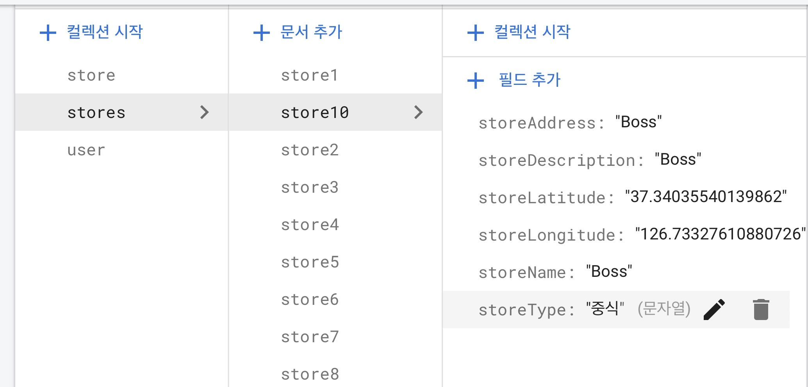
Server
Store Add
NEPTUNE
Neptune is the eighth planet.

Slide 13
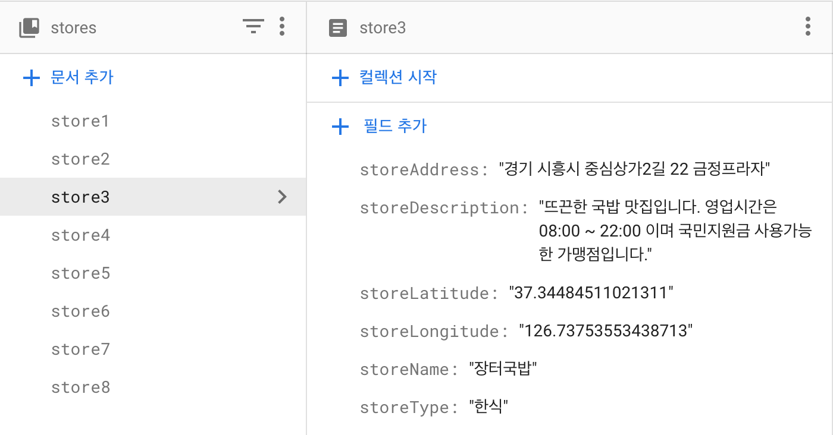
Store Info
Server
NEPTUNE
Neptune is the eighth planet.

Slide 14
Store List
NEPTUNE
Neptune is the eighth planet.

Slide 15
My Page
NEPTUNE
Neptune is the eighth planet.

Slide 16
Sign Out
NEPTUNE
Neptune is the eighth planet.

Slide 17
Thanks!

